Slide 1
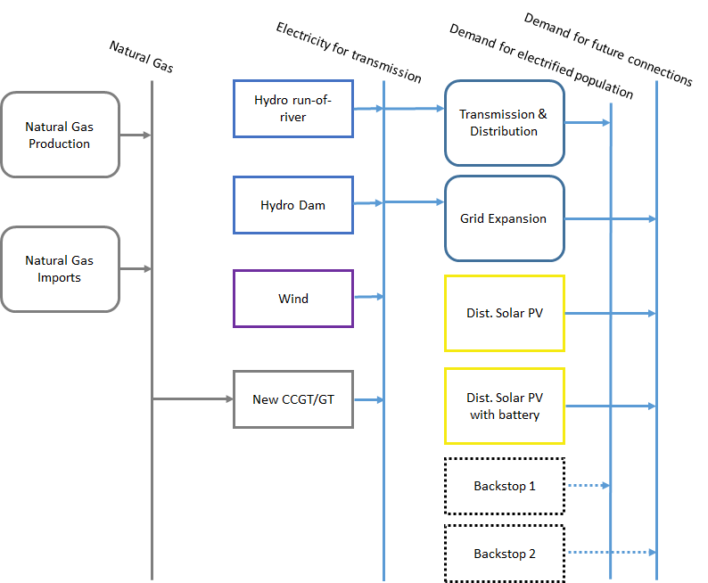
General representation of a technology
Resources
Primary
Secondary
Final

Slide 2
General representation of a technology
Resources
Primary
Secondary
Final

Slide 3
General representation of a technology
Examples
Coal
Coal extraction
Gas
Electricity
Gas Power plant
Oil
Gasoline
Refinery
Diesel
Kerosene
Diesel
Passenger-km
Car

Slide 4
Key characteristics of a technology
Input commodity
Source
Quality
Availability
Price
Domestic availability / import capability
Impact
Output commodity
Demand level & type
When is it needed
Energy content
Production targets
Export targets
Impact
Technology
Techno-economic-environmental characteristics
Capital cost
Variable & Fixed Operating costs
Emission factor
Efficiency
Energy intensity
Availability
Capacity factor
Lifetime
Ramping capability
….

Slide 5
General representation of a technology
A model is an abstracted representation of the real world.
Therefore, one technology in OSeMOSYS can represent:
One single process/plant or
A group of processes/plants with similar characteristics, if no further detail is needed, e.g.
One technology to represent a set of existing coal-power plants;
The aggregation of transmission and distribution networks

